Slide 1
Digital Transformation of SATCOM Networks
Juan Deaton

Slide 2
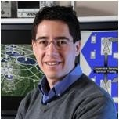
Hello!
Juan Deaton, Ph.D.
jdeaton@envistacom.com
Bio:
Dr. Juan Deaton is currently a research scientist at Envistacom, where he is using his 20 years of telecom experience and research to build virtualized transport satellite systems. In his previous employment with Comtech EF Data, he was engaged in variety of different types of research like anti-jam waveforms, satellite channel models, and developing LDPC codes for Versa FEC 2. Before working at Comtech EF Data, he worked for the Idaho National Lab, where he researched spectrum optimization, spectrum modeling, and emergency communications. Before the INL, Juan worked for Motorola’s CDMA network division, where he was the recipient of the 2005 CDMA quality award for developing hands-on training for CDMA cellular equipment deployments. His patented and published work includes spectrum sharing in cellular networks, wireless airborne emergency communications, and mobile advertising. His M.S. and Ph.D. degrees were earned from Virginia Tech and BSEE from the University of Idaho.

Slide 3
Introduction
Purpose
The purpose of this brief is to explain the digital transformation of SATCOM.
Outline
Introduction
Digitization of SATCOM Networks
Virtualization of SATCOM Networks
Use Cases

Slide 4
Introductions
“It is not the strongest of the species that survives, nor the most intelligent that survives. It is the one that is most adaptable to change.”
Charles Darwin

Slide 5
Motivation
Rapidly Changing Space Layer
New LEO, MEO, and GEOs
Demand for SATCOM
21% CAGR
Stove-Piped, Isolated Systems
Independently non-interoperable systems

Slide 6
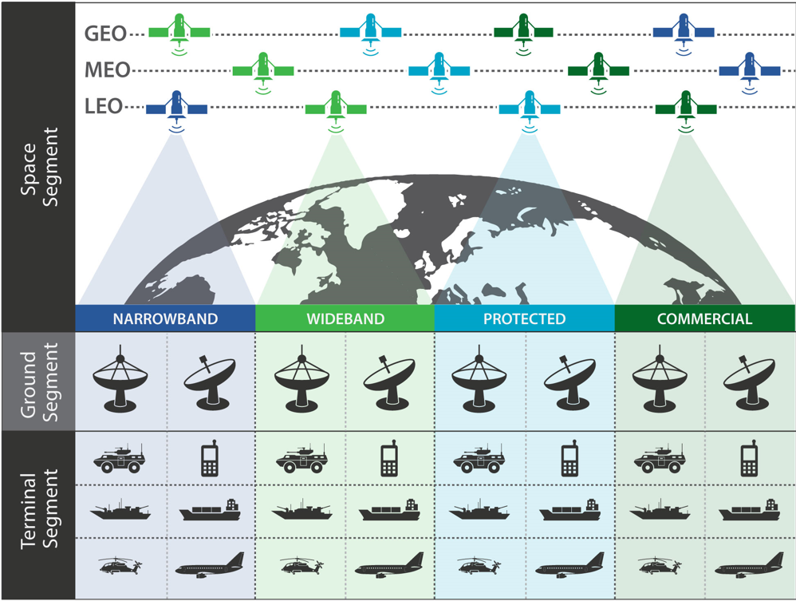
DoD SATCOM Complexity and Variegation
50,000 Active Satellites in the Next 10 Years
17,000 DoD Terminals
135 Different Types

Slide 7
Key Demands for SATCOM Networks
Key Demand-1
Freedom From Vendor Lock-in
Proprietary-based modems complicate networks, logistics, migration, increase costs, and contribute to stove-piped systems. Vendor lock-in business models are an antiquated way of doing business that form rigid oligopolies that limit innovation and technology progression.
Key Demand-2
Reduction in Total Cost of Ownership (TCO)
Operating and capital expenses are key drivers in network sustainability. In commercial networks, managing SATCOM networks’ costs is important in maintaining profitability. In DoD networks, managing SATCOM networks’ costs is important in maintaining network longevity.
Key Demand-3
Ground Segment Sustainability
Operational complexity adds cost and increases logistical footprint, which creates upgrade stagnation. Migration paths to new technology should have minimal network impacts.
Key Demand-4
Terminal/Modem Agility
Terminal segments, along with their antennas, need to operate on multiple waveforms, bands, and orbits. Modems should also operate on a variety of waveforms.
Key Demand-5
System Agility/Resiliency
SATCOM ground and terminal segments should deploy automated configurations based on mission needs, maintained connectivity through contested environments, and changing network demand.
Key Demand-6
High Computational Density/Efficiency
The demand for reduced size, weight, and power (SWaP) is ever present. Rack space in many networks is reaching capacity, creating additional operational costs to meet the increasing demand for throughput.
Notes:
Idirect – I support depends on how much hubs yo uhave 1.4/ 1.6 M a yuear to support network
Current card swill last 2/3 revs before needing to buy new hardware, 3-5 all hardware needs to be replace and rigged game. Apple iPhone battery analogy
More bandwidth with smaller about of footprint with same amount of capability.
Had held modem that fits in your hand that fits in your hand. You can fit a lot of those in hand and fit a lot in rack and another works in case.
USB philosophy, Hub will be able to redirect onto a new transponder, without manual intervention.
Idirect has a key feature that has good global management that does the worldwide network to move from transponder to transponder, terminals that can move locations and change to new birds.
Global management of all terminals in the network everything that comes up in the network. STS Codemettle has some growth, all have issues . Real estate and power are the most expensive things STT we don’t want to pay for an ACU. RHN we need to use a different antennas.

Slide 8
Components of the Digital Transformation
Digital Transformation
Virtualization
Advanced
Antennas
Digitization
NFV
Digital IF Modem
Digital IF Protocol
Edge Device
OSS/BSS
Hybrid
Cloud
MANO
Common Hardware Platforms

Slide 9
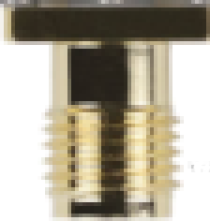
Traditional vs. Digitized
Baseband Modem
RF Front End
IP Data
10101011
TX
L-band IF
RF
RX
Modem
RF Transmission
Digital IF Modem
Edge Device
Digital IF

10101011
TX
IP Data
L-band IF
RF
RX

Slide 10
Virtualization Overview
Virtualized Infrastructure
Virtualized Environment
Waveform
VNF-1
WAN Accel
VNF-2
QoS
VNF-3
CPU
RAM
MEM
NIC
10101011
Digital IF Modem
Notes:
Different to moving to PC for what OS you want to load on it. Apps like a iPhone. Multiple vendors will join in and everything will get cheaper and become commondity products.

Slide 11
Digitization of SATCOM Networks
“The first step to this dynamic ground architecture is replacing existing analog Intermediate Frequency (IF) interfaces with an open, interoperable digital standard ...”
Maj. Gen. Lawrence A. Stutzriem, USAF (Ret.)

Slide 12
Digitization of SATCOM Networks
Digital Transformation
Virtualization
Advanced
Antennas
Digitization
NFV
Digital IF Modem
Digital IF Protocol
Edge Device
OSS/BSS
Hybrid
Cloud
MANO
Common Hardware Platforms

Slide 13
Digitized Architecture
Digital IF Modem
Edge Device
Digital IF
IP Data
10101011
TX
L-band IF
RX

Slide 14
Ground Segment Gateway
L-Band
Switching System
RF Transmission
Proprietary Modem Bank
Switch Matrix
Combiner/Splitter

RF
External Data
Networks

L-band IF

Electronics Equipment Building
IFL
~1000 ft
Shelter
IFL
~100 ft
Notes:
TT&C another gateway for doing TT&C and separate. Controls uses the internet databased to update ephemeris. Move to LEO they will need to get a Ephemeris. ACU can’t touch the antenna. There need for an data base. ACU Leo, John Lane was out there to figure out how the ephemeris gets entered in. Ground segment is separate from TT&C networks.

Slide 15
Digitized Ground Segment
Digital IF
Modem Bank
Digital IF
LAN
Local Sites
Local Teleport EEB
Edge Devices
100/400 GbE

External Data
Networks


DIFL
2-40 km
Digital IF
WAN
DIFL
Unlimited
Remote Site


Slide 16
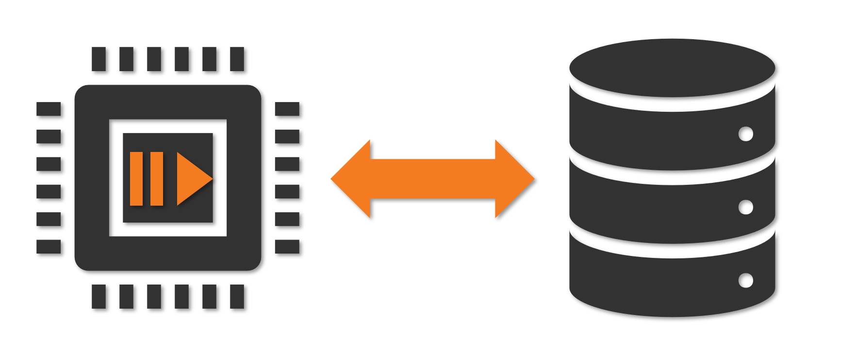
Ground Station as a Service (GSaaS)
VITA 49.2
RTP
UDP/IP
802.3
<100 MHz
Digital IF
Stack
VITA 49.2
10G
Waveform
Processing
Edge
Device
Proprietary
Digital IF
Storage
Data Products

Slide 17
Enterprise Digital IF Multi-Carrier Modem (EDIM)
Digital IF
Digital IF
L-band
Edge Device
DMB
DAD
L-band IF
RF

External Data
Networks


Digital IF
WAN
Remote Site


Slide 18

DIFI Protocol Stack
OSI
Stack
v1.0
Data
VITA 49.2
Data representation of digital samples, context, timing, and control.
Session
TBD
Flow Control: Reliable, low latency
Packet Loss Recovery: Retransmissions, forward erasure correction
Security: Authentication, encryption
Transport
UDP/IP
Standard IP-Based Protocols
Data Link
802.3
Physical

Slide 19
Key Challenges With Digital IF Transport
Flow Control
Definition:
The ability to deliver digital sample packets at a rate match to the sample rate of the consumer
Buffer-flow problem:
Packets are received too fast or slow such that the digital sample consumer receives gaps in transmission
Techniques:
Backpressure in L2 switched networks using 802.3 priority pause frames
Timestamping and clock synchronization between transmitter and receiver for L3 routed networks
Packet Loss Recovery
Definition:
The ability to recover lost packets in the network in time to guarantee reliable delivery with minimal latency
Techniques:
Retransmissions of lost packets is used by TCP to guarantee reliable transport
Packet FEC minimizes the need for retransmissions by sending extra packets for data reconstruction
Security
Definition:
The protection from interception or redirection of digital streams data
Techniques:
AES and authentication

Slide 20
Virtualization of SATCOM Networks
“...the [SATCOM] enterprise needs to improve its resiliency, robustness, flexibility, and manageability.”
William J. Liquori Jr., Major General, USAF

Slide 21
Digitization of SATCOM Networks
Digital Transformation
Virtualization
Advanced
Antennas
Digitization
NFV
Digital IF Modem
Digital IF Protocol
Edge Device
OSS/BSS
Hybrid
Cloud
MANO
Common Hardware Platforms

Slide 22
Virtualization Overview
App
App
App
App
Application
OS
OS
OS
OS
Operating System
Hypervisor
Common
Hardware
Common
Hardware

Slide 23
Network Function Virtualization Architecture
MANO
Application
Portal
Network
Configuration
Portal
Billing
Accounts
Service
Orchestrator
OSS/BSS
VNF 1
Virtual
Network
VNF
4
VNF
Manager
VNF
VNF 2
VNF 3
Infrastructure
Manager
Hypervisor
CPU
CPU
CPU
NFVI
CPU
CPU
CPU
CPU
Storage
Network

Slide 24
Virtualized Ground Segment
MANO
Application
Portal
Network
Configuration
Portal
Billing
Accounts
Service
Orchestrator
OSS/BSS
Network Management System
VNF
Manager
Virtual Network
& SATCOM
Functions
Digital IF
Transport Hosts
VNF
VN
Infrastructure
Manager
Hypervisor


NFVI

DMB
DIL
Edge Devices
RF Transmission

Slide 25
OSS/BSS
User / Operator
1. Service Order
6. Monitoring and Control
OSS/BSS
2. Service Chain Request
5. Service Confirmation
MANO
4. Create and Configure
Service Chain
3. Allocate and
Configure
Resources
VNF
SD-WAN
Virtual
Waveform
Digital IF VLAN
Digital IF Host
NFVI

Slide 26
Use Cases
“User terminals will be capable of multi-band and multi-waveform operations, whenever possible, to support agile, ‘path-agnostic’ connectivity, reducing vulnerability to interference and jamming.”
William J. Liquori Jr., Major General, USAF

Slide 27
Modem/Terminal Agility
Wave-1
Wave-1
Wave-2
Monitor
Wave-2
Monitor
MANO
AI Class
MANO
AI Class
Wave-N
Wave-N
Wave-1
Wave-2
Wave-1
Wave-2
VNF
Monitor
AI Class
Monitor
AI Class
VNF
DTS-1
SAT-1
NFVI
DTS-2
DIL
DM
NFVI
SAT-2
Terminal-1
DMB
DIL
Gateway
NFVI
DIL
DM
Terminal-2

Slide 28
System Agility/Resiliency
SAT-1
NFVI
NFVI
Terminal-1
SAT-2
Local Gateway
NFVI
DIFL
Terminal-2
SAT-3
NFVI
NFVI
Remote Gateway
Terminal-3

